Slide 1



Telco_Customer_Churn
View in Power BI
Last data refresh:
10/11/2025 11:12:08 AM UTC
Downloaded at:
10/12/2025 3:50:04 PM UTC

Slide 2
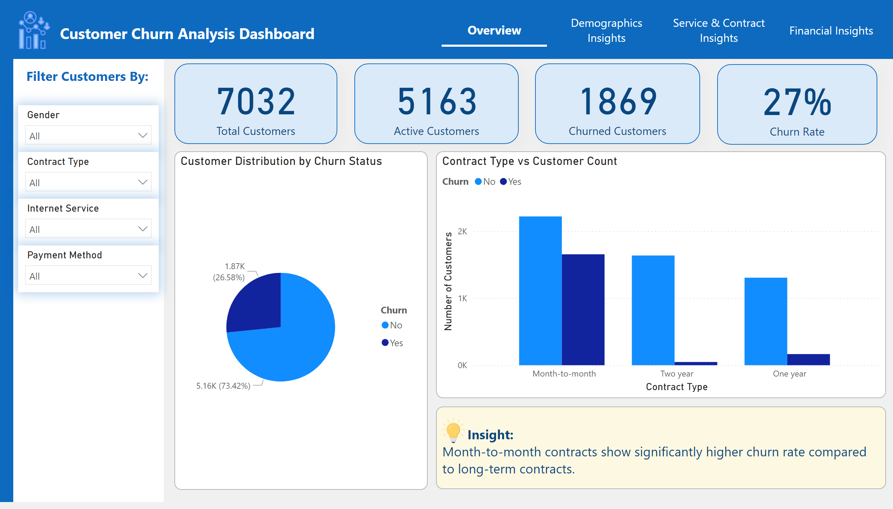
Overview
Notes:
shape
No alt text provided
shape
No alt text provided
shape
No alt text provided
textbox
No alt text provided
image
No alt text provided
textbox
No alt text provided
slicer
No alt text provided
slicer
No alt text provided
slicer
No alt text provided
card
No alt text provided
card
No alt text provided
card
No alt text provided
card
No alt text provided
Customer Distribution by Churn Status
No alt text provided
Contract Type vs Customer Count
No alt text provided
slicer
No alt text provided
textbox
No alt text provided
image
No alt text provided
pageNavigator
No alt text provided

Slide 3
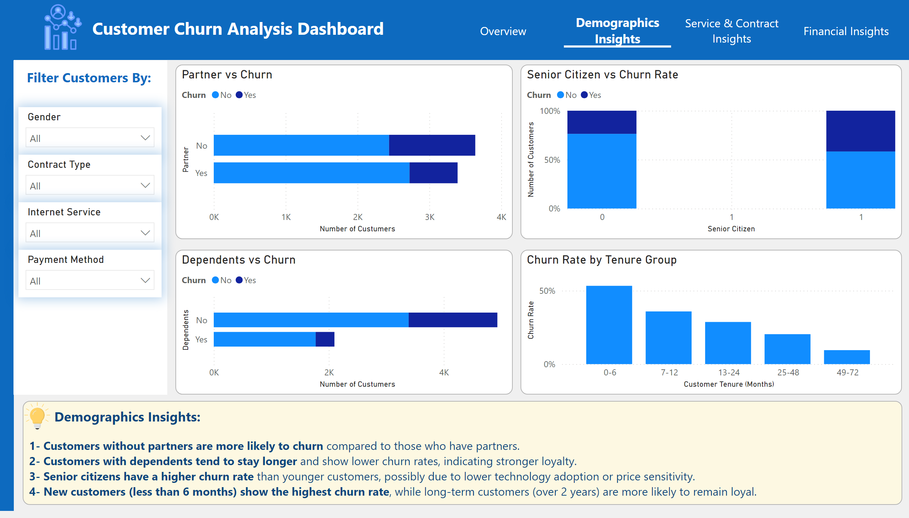
Demographics Insights
Notes:
shape
No alt text provided
shape
No alt text provided
shape
No alt text provided
textbox
No alt text provided
image
No alt text provided
textbox
No alt text provided
slicer
No alt text provided
slicer
No alt text provided
slicer
No alt text provided
Partner vs Churn
No alt text provided
Senior Citizen vs Churn Rate
No alt text provided
slicer
No alt text provided
Dependents vs Churn
No alt text provided
Churn Rate by Tenure Group
No alt text provided
textbox
No alt text provided
image
No alt text provided
pageNavigator
No alt text provided

Slide 4
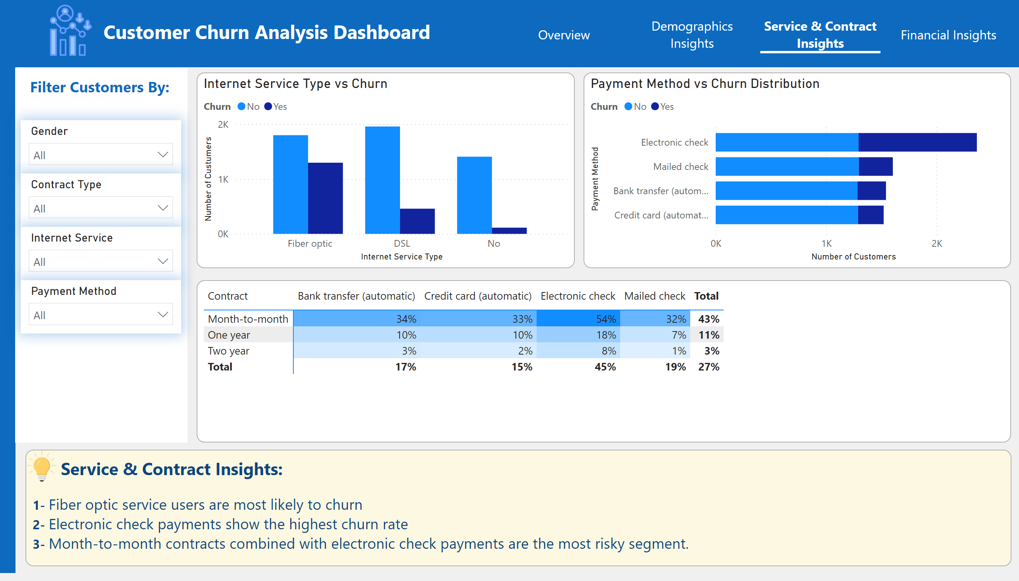
Service & Contract Insights
Notes:
shape
No alt text provided
shape
No alt text provided
shape
No alt text provided
textbox
No alt text provided
image
No alt text provided
textbox
No alt text provided
slicer
No alt text provided
slicer
No alt text provided
slicer
No alt text provided
Internet Service Type vs Churn
No alt text provided
Payment Method vs Churn Distribution
No alt text provided
slicer
No alt text provided
Dependents vs Churn
No alt text provided
textbox
No alt text provided
image
No alt text provided
pageNavigator
No alt text provided

Slide 5
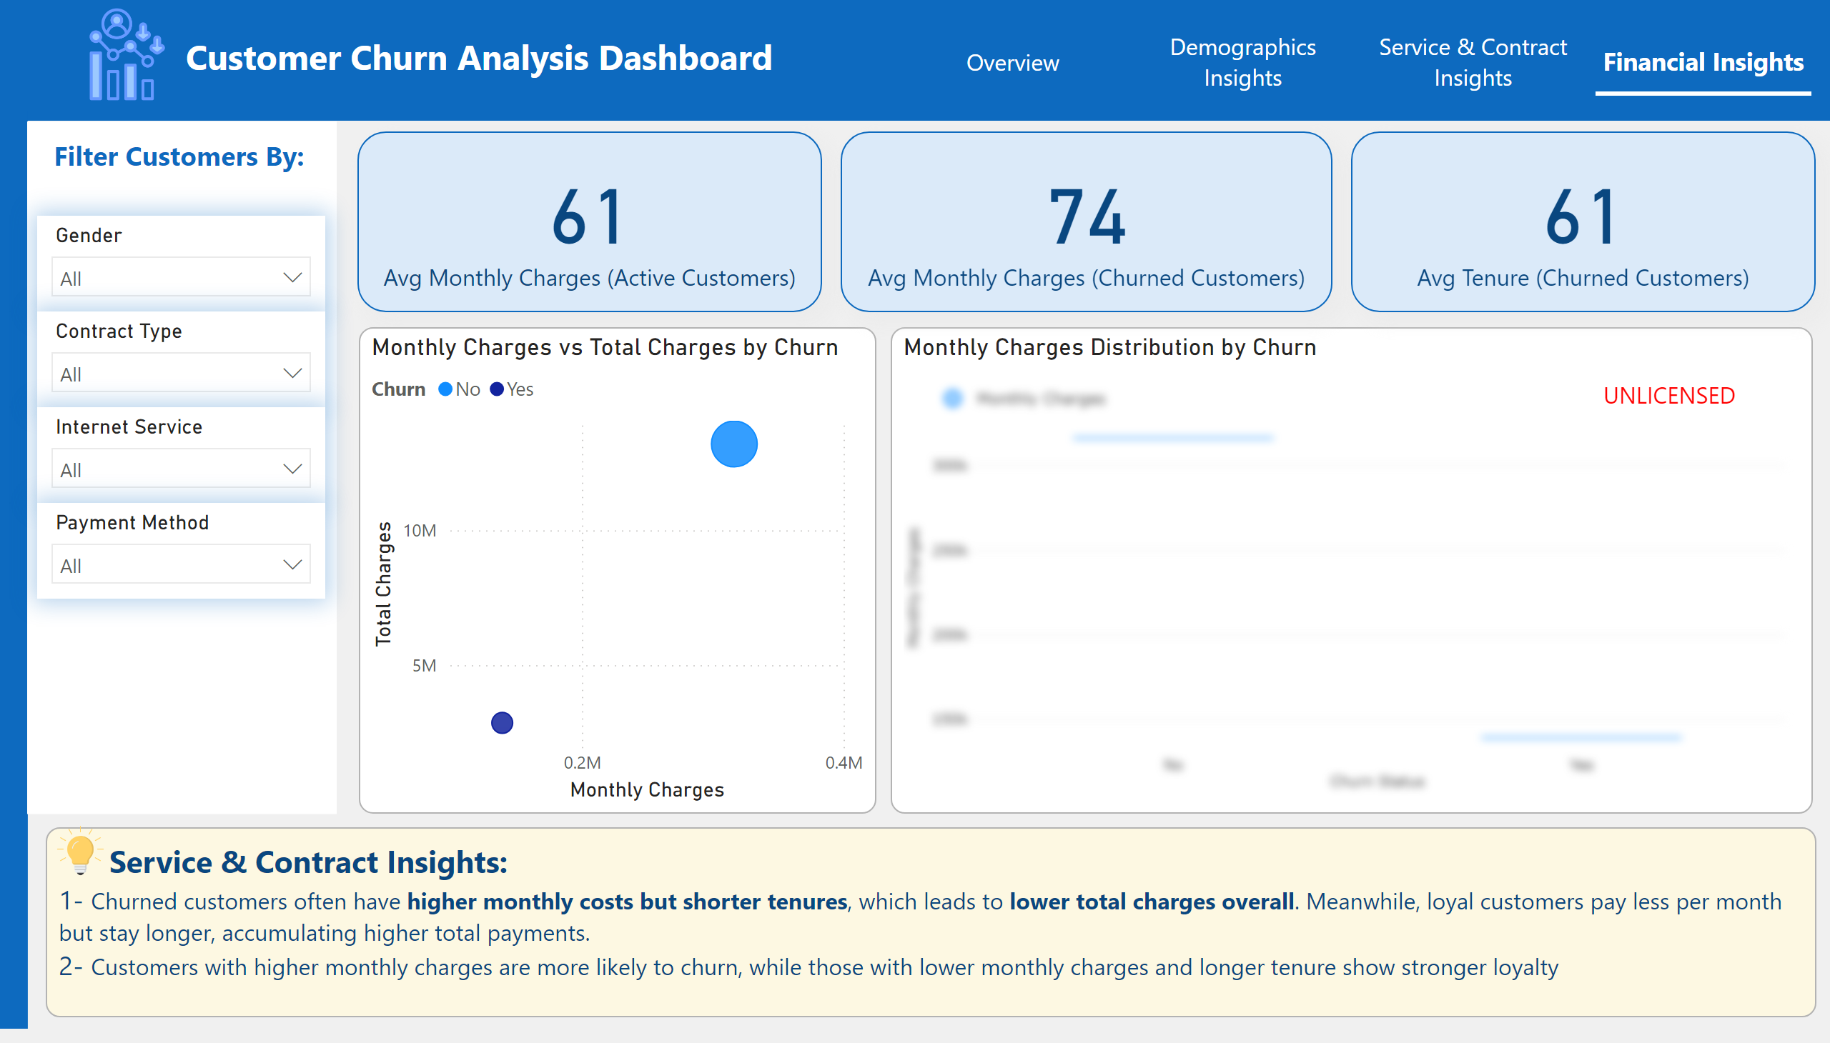
Financial Insights
Notes:
shape
No alt text provided
shape
No alt text provided
shape
No alt text provided
textbox
No alt text provided
image
No alt text provided
textbox
No alt text provided
slicer
No alt text provided
slicer
No alt text provided
slicer
No alt text provided
card
No alt text provided
Monthly Charges vs Total Charges by Churn
No alt text provided
Monthly Charges Distribution by Churn
No alt text provided
slicer
No alt text provided
card
No alt text provided
card
No alt text provided
textbox
No alt text provided
image
No alt text provided
pageNavigator
No alt text provided

